Slide 1

SKN Sinhgad College of Engineering
Korti -Pandharpur
Presentation On Project
Tittle of Project : “YOUTUBE VIDEO SUMMARIZATION”
Name of Department : Computer Science and Engineering
Class : TY BTECH
Academic Year : 2023-2024

Slide 2
Presented By
Ms. Gauri Shashikant Pawar
Ms. Nikita Vivek Pawar
Ms. Sakshi Vikas Pawar
Ms. Rutuja Savata Raut
Project Guide
Asst.Prof. S.G.Linge

Slide 3
Contents
Introduction
Objective
Methodology
Module
Software Requirement
Hardware Requirement
Conclusion

Slide 4
Introduction
Automatic summarization is a technique for quickly introducing key information by abbreviating large sections of material.
Summarization may apply to text and video with a different method to display the abstract of the subject Some videos are long and boring or take more time to display the information that sometimes finds in a few minutes.
Therefore, the essence of the proposed system is to find the way to summarize the long video and introduce the important information to the user as a text with few numbers of lines to benefit the students or there searchers that have no time to spend with long videos for extract the useful data

Slide 5
Objective
To develop system for summarizing YouTube videos to provide users with concise and informative summaries.
To understand and review current algorithms and methods for video summarization.YouTube videos will be collected for analysis and summarization
To extract audio from the youtube videos & making small units of that MP4 audio
To convert speech to text using speech recognization
To summarize the key points from that video

Slide 6


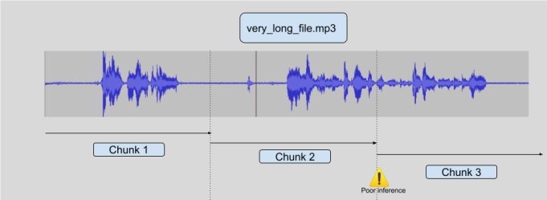
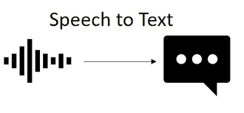
Block Diagram
Automatic summarization is a technique for quickly introducing key information by abbreviating large sections of material.

Slide 7
Modules
We follow 4 modules at the time of creating our module and they are as follow:
1.Download a audio
2. Chunk Audio
3. Transcription of audio
4. Summary
Module 1:Download a audio:
When we take you tube video link then initially we need to convert them into audio mp4 format and download that audio at specific location.
Pythonic library (pytube) used for download YouTube video and then for converting them into audio we use moivepy library.

Slide 8
Module 2:(Chunk Audio)
Breaking audio into smaller chunks makes it more manageable for various tasks, including analysis, feature extraction, and modelling. It simplifies the handling of audio data during the development and implementation of algorithms. For that Librosa can be used to load audio files, and you can easily segment or chunk audio data using its utilities.
Module 3:(Transcription Of Audio):
Transcription of audio refers to the process of converting spoken words or audio content into written text . You can use libraries that utilize Automatic Speech Recognition (ASR) systems.
Module 4:(Summarization)
Finally we summarise the key points.

Slide 9
Hardware & Software Requirement
Hardware Requirements:
Computer
Storage (decent amount of RAM 16 GB )
Software Requirements:
Programming Language and IDE: Python Language, Jupyter Notebook
Video Processing Libraries: Libraries like OpenCV or FFmpeg
Natural Language Processing (NLP) Libraries: Libraries like NLTK, or Gensim provide tools for tasks like speech recognition, text analysis, and summarization.

Slide 10
Conclusion
Conclusion: The project successfully demonstrates the feasibility and effectiveness of automated YouTube video summarization
Future Scope: Explore integrating advanced AI techniques to enhance summarization accuracy and efficiency. We can also create chrome extension in future.
Benefits: Saves time for viewers by providing concise video summaries, improves accessibility to video content, and supports better decision-making through quick information retrieval.

